Slide 1
LESSON 2
Formatted Output and File IO
Random class
The ArrayList – A Generic
Iterators
CSC 300
Fall 2026
Howard Rosenthal

Slide 2
Course References
Materials for this course have utilized materials in the following documents. Additional materials taken from web sites will be referenced when utilized.
http://www.programmedlessons.org/Java9/index.html
Anderson, Julie and Franceschi, Herve, Java Illuminated 5TH Edition,, Jones and Bartlett, 2019
Bravaco, Ralph and Simonson, Shai, Java Programming From The Ground Up, McGraw Hill, 2010
Deitel, Paul and Deitel, Harvey, Java, How To Program, Early Objects, Eleventh Edition, Pearson Publishing, 2018
Gaddis, Tony, Starting Out With Objects From Control Structures Through Objects, Seventh Edition, Pearson Publishing, 2019
Horstmann, Cay, Core Java For The Impatient, Addison Wesley- Pearson Education, 2015
Lecessi, Ralph, Functional Interfaces In Java, Apress, 2019
Naftalin, Maurice and Wadler, Philip, Java Generics and Collections, O’Reilly Media, 2007
Schmuller, Joseph, Teach Yourself UML In 24 Hours Second Edition, SAMS Publishing, 2002
Urma, Raoul-Gabriel, Fusco, Mario and Mycroft, Alan, Java 8 in Action: Lambdas, Streams, and Functional-Style Programming, Manning Publishing, Second Edition 2019
Wirfs-Brock, Rebecca, Wilkerson, Brian and Wiener, Laura, Designing Object-Oriented Software, Prentice Hall, 1990
Oracle On-Line Documentation and Tutorials, https://docs.oracle.com

Slide 3
Links
https://howtodoinjava.com/java8/lambda-expressions/
https://www.javatpoint.com/java-8-method-reference
https://howtodoinjava.com/java8/lambda-method-references-example/
https://examples.javacodegeeks.com/java-functional-interface-example/
http://tutorials.jenkov.com/java-functional-programming/streams.html#java-stream-definition
https://howtodoinjava.com/java8/java-streams-by-examples/
Significant Portions of the following reference are used in this lesson:
Urma, Raoul-Gabriel, Fusco, Mario and Mycroft, Alan, Java 8 in Action: Lambdas, Streams, and Functional-Style Programming, Manning Publishing, Second Edition 2019

Slide 4
Lesson Goals
Using the Scanner
Printing and Formatted Printing
Reading and writing from Files
  The File Class – creating a File object
    Review FileWriter for appending to files
  Creating a Scanner object to read from a File Object
  Creating a PrintWriter object to write to a File object
  Creating a FileWriter object to allow appending to a file
Reviewing the Random class
The ArrayList as a generic class with a type parameter
  Methods that are useful with an ArrayList
Understanding the Iterator and the enhanced for loop mechanisms

Slide 5
Using The Scanner

Slide 6
Obtaining Input Data Using Scanner
Scanner is a class.
You must include the following statement to use the class to create a Scanner object:
import java.util.Scanner; or import java.util.*;
  You are importing a class with all it’s methods that can then be used to create objects
Declare a Scanner object variable and create an object:
Scanner scannerName = new Scanner (System.in);
  new means you are creating a new object – new is a reserved word
  System.in is a variable that tell the Java program that this input stream is coming from the keyboard
You can now access seven types of primitive input: byte, short, int, long, double, float and boolean using predefined methods associated with the Scanner class
  A Scanner object doesn’t read characters
  The scannerName is just another variable name
    It contains an address which refers to the Scanner object you have created

Slide 7
There are 7 Input Methods Available For Primitive Data Types
scannerName.nextByte()
scannerName.nextShort()
scannerName.nextInt()
scannerName.nextLong()
scannerName.nextDouble()
scannerName.nextFloat()
scannerName.nextBoolean()
Note: the type names are capitalized in these methods
Note: There is no way to directly input a char with a Scanner object
What you are looking at above is the standard way objects access methods:
objectname.method(par1, par2, …)
There are no parameters required for the Scanner methods

Slide 8
A Scanner Object Is Created From The Scanner Class
keyboard
Name0f input file (System.in)
Constructor –used to create object
Methods nextByte() nextShort() nextInt() nextLong() nextFloat() nextDouble() nextBoolean() next() nextLine() hasNext() hasNextInt() o 0 0

Slide 9
The next() and nextLine() Methods (1)
next() reads in the next contiguous non-blank set of characters as a String
  It works like the primitive methods, except that it reads in a String
nextLine()
  Advances the Scanner to the beginning of the next line and returns a reference to a String object comprised of the characters that were read (or skipped if you wish) in the process, including whitespace, but not including the newline character
System.out.printf(“Enter message on one line: “);
String message = keyboard.nextLine();
System.out.printf(“Enter an integer in the range 0-25: ”);
int shift = keyboard.nextInt();
If the inputs are:
Cato
8
then message refers to Cato and shift gets the value 8.

Slide 10
The nextLine() Method (2)
However, if you reverse the process:
System.out.printf(“Enter an integer in the range 0-25: ”);
int shift = keyboard.nextInt();
System.out.printf(“Enter message on one line: ”);
String message = keyboard.nextLine();
The results are different:
  In the second case once you read the 8 the Scanner still hasn’t moved to the next line – nextInt() doesn’t read one int and move to the next line
    The nextLine() then sees nothing prior to the line return and returns an empty String
In this case using next instead of nextLine fixes the problem because next looks for a non-blank character
  However, you must remember that next only reads from a non-blank character and stops when it hits a blank
See NextLineTester.java

Slide 11
Using the split() method to parse a String
The String [] split(String delimiter(s), int limit) method allows you to split a String into multiple Strings placed into an array with a length equal to the number of splits
The pattern if can look like this
  “ ” – a single space
  “ +” – multiple spaces
  “[#,: ]” – any of these works
  “[#,:]+” - any of these works in a combination
Please note that using split with human generated inputs has its dangers
  Note the use of + outside the characters can mitigate this issue
Use of limit
  limit = 0 – ignore trailing blanks (most used case)
  limit > 0 - Splits at most (limit – 1) times all the rest is placed in the last cell of the array
  Limit < 0 - Splits fully, keeps trailing empty Strings
See See CountingWords.java, CountingWordsParsing.java
More examples at https://www.geeksforgeeks.org/java/split-string-java-examples/

Slide 12
A String May Be Parsed To Extract Numeric Data
There are static methods for converting correct String data to the appropriate data types
  This will be especially helpful when receiving data from GUI sessions
Note that these are class methods (we aren’t creating objects to access these methods – they are all in java.lang package so no import is necessary
Primitive Type | Wrapper Type | Method
byte | Byte | byte Byte.parseByte(String str)
short | Short | short Short.parseShort(String str)
int | Integer | int Integer.parseInt(String str)
long | Long | long Long.parseLong(String str)
float | Float | float Float.parseFloat(String str)
double | Double | double Double.parseDouble(String str)

Slide 13
Using A Scanner To Parse A String (2)
To specify different delimiters, call the useDelimiter method:
  Scanner useDelimiter( String pattern )
  sets the delimiter to pattern and returns this Scanner object.
  i.e. parse.useDelimiter(“,”);
Here, pattern represents a regular expression against which to match sequences of characters using standard characters as well as meta-characters, which have special meanings.
We can specify a delimiter consisting of a single character or multiple specific characters as a simple String argument.
See UsingScannerToParseAString.java

Slide 14
A Practical Example Using Scanner
import java.util.Scanner; // Make the Scanner class available.
public class Interest2WithScanner
{
public static void main(String[] args)
{
Scanner keyboard = new Scanner( System.in ); // Create the Scanner.
double principal; // The value of the investment.
double rate; // The annual interest rate.
double interest; // The interest earned during the year.
System.out.printf("Enter the initial investment: "); //always ask for an input with a question
principal = keyboard.nextDouble();
System.out.printf("Enter the annual interest rate as a percent");
rate = keyboard.nextDouble();
rate = rate/100;
interest = principal * rate; // Compute this year's interest.
principal = principal + interest; // Add it to principal.
System.out.printf("The value of the investment after one year is $ %.2f\n”, principal);
}
} // end of class Interest2withScanner

Slide 15
Printing

Slide 16
Printing and Special Characters
The System.out object is a predefined instance of a class called PrintStream, and is included with the basic java.lang and package therefore is always available for use without the need for an import statement.
  It is called the standard output object, and prints to the terminal
  We will learn how to print to other File objects later in this term
There are several basic static methods from this class
  System.out.println(“abc”) // prints the String and a character return
  System.out.print (“abc”) // prints a String without a character return
  There is. Printf, which I will be explaining in detail and which I want you to use, shortly
Escape sequences inside the String can be used to control printing
Escape Sequence | Character
\n | newline
\t | tab
\b | backspace
\f | form feed
\r | return
\" | " (double quote)
\' | ' (single quote)
\\ | \ (back slash)
\uDDDD | character from the Unicode character set (DDDD is four hex digits) – used when the character isn’t available during input

Slide 17
Printing Example
public class PrintAPoem
{
public static void main (String[] args)
{
System.out.print (“He wrote his code\n”);
System.out.print(“\tHe indented well\n”);
System.out.print(“\tTill he was done\n”);
System.out.print(“\nThe Author\n”);
}
}
He wrote his code
He indented well
Till he was done
The Author
System.out.println(concatenated String) – prints and goes to the next line
System.out.print(concatenated String) – prints and stays on the same line

Slide 18
Printing Example – Concatenation in Print Statements
When you write expressions in a System.out.println() statement the expression may or may not be calculated first, depending on if and where you put the parentheses
  The rules are exactly the same as used when concatenating String(s)
  Ultimately the println method will output a single String
public class PrintingNumbers //Class name
{
public static void main ( String[] args )
{
System.out.println("The sum of 5 + 6 is " + (5+6));
System.out.println("The sum of 5 + 6 is " + 5+6);
System.out.println("The sum of " +5 +" + " +6 + " is " +(5 + 6));
}
}

Slide 19
Formatted Printing Using The printf Method

Slide 20
Notice And Warning
Every Semester There Are Students Who Want To Stick With Their OLD Methods Rather Than Learning How To Use the formatted printing method printf
If you do not use this method and your output formatting is incorrect in any way you will lose points on any homework and/or exams

Slide 21
Formatted Printing with printf (1)
System.out.printf(“ characters %format1 characters %format2 characters %format3”, varorconst1, varorconst2, varorconst3);
The first parameter is a String (in double quotes) that lays out the sentence and format for each variable, and includes special control characters
There is a one to one mapping of format to variable
The variable must match the format type
Example
System.out.printf(“The average of %,d students taking %d exams is %3.2f\n”, 1250, 4, 78.655); // prints out as:
The average of 1,250 students taking 4 exams is 78.66
Each format specification begins with % and ends with the format specifier type (see next page)

Slide 22
Formatted Printing with printf (2)
For simple formatted outputs, each format parameter aligns to the subsequent variable or constant after the String
It is possible to more clearly format your output with the printf method
  Width, precision, leading blanks, signs, etc. can all be controlled
The printf method has a String followed by a number of primitive or object variables to be printed
  You can also specify formatting a geographic area, but we’ll ignore that for now
Please use printf as opposed to println and print in this class to the greatest extent possible
Nice reference
  http://www.java2s.com/Tutorial/Java/0120__Development/UsingJavasprintfMethod.htm

Slide 23
Some Key Conversion Character Specifiers For Formatted Output
Specifier | Name | Example
%b or %B | boolean | false or FALSE
%c or %C | character | f or F
%d | decimal integer | 189
%e | exponential floating | 1.59e+01
%f | Floating point number | 15.9
%s or %S | String if “Java” | Java or JAVA
%x or %X | Hexadecimal integer | 1f2a or 1F2A
%% | The percent symbol | %
We will also learn several other important elements that can be combined with the specifiers
  Flags – for left justified, etc.
  Width - specifies the field width for outputting the argument and represents the minimum number of characters to be written to the output
  Precision - used to restrict the output depending on the conversion and specifies the number of digits of precision when outputting floating-point values.

Slide 24
Important Control Characters
Control Character | Name
\n | new line
\t | tab
\\ | Prints \
Always placed inside the String

Slide 25
Formatted Integer Output Using The d Specifier
The %wd means reserve a minimum of w spaces, right justified
The – in %-wd means left justified
The 0 in %0wd means left fill with 0’s
The + in %+d means add a positive sign for positive numbers
A ( encloses a negative number in parentheses
A , is used as a group separator (may work differently outside of U.S.)
See Printf1.java

Slide 26
Formatted Floating Point Output Using The f Specifier (1)
For simple formatted outputs, each format parameter aligns to the subsequent variable or constant after the String
public class Printf2
{
public static void main(String[] args) {
double x = 27.5, y = 33.75;
System.out.printf("x = %f y = %f\n", x, y);
}
}
Output: x = 27.500000 y = 33.750000

Slide 27
Formatted Floating Point Output Using The f Specifier (2)
Uses the same formatting structures as integers
Adds the ability to specify the number of decimal places to the right of the decimal point, as opposed to printing a minimum of a default 6
%w.nf has a minimum width of w and n decimal places
%#w.nf – the # guarantees a decimal point
Variable associated with f must be of type double or float - it won’t cast up any type of integer
Note: On some machines it may not do a perfect job in rounding as it uses bankers rounding
  Bankers Rounding is an algorithm for rounding quantities to integers , in which numbers which are equidistant from the two nearest integers are rounded to the nearest even integer.
      Thus, 0.5 rounds down to 0; 1.5 rounds up to 2.
  It has been extended to be used at any level of precision
    1.685 would print to two places as 1.68 while 1.675 would also round to two places as 1.68
See See Printf3.java

Slide 28
Controlling Other Formatted Outputs (1)
  Strings with %-ws
    - will left justify
    w specifies width
    s is for a String
    If s is capitalized then the entire String prints capitalized
    We will learn how to use String variables later this semester
  Same rules apply for c (char) and b (boolean)
  See Printf4.java

Slide 29
Formatted Printing With printf – Putting It All Together
See Printf5.java

Slide 30
Reading and Writing From Files

Slide 31
Files
A file is a collection of data saved under a single name
  Files can be structured or free text
  Java creates File objects
  Once a File object is instantiated you can read or write from the file
    This is very convenient when testing programs, since you can use the same data over and over again
Most of the inputs for homework will require reading from files

Slide 32
Processing Streams
A processing stream operates on the data supplied by another stream.
Often a processing stream acts as a buffer for the data coming from another stream.
    Character streams are intended exclusively for character data. – We are using Character Streams most often in this class
    In java the characters are in 16 bit Unicode
  Byte streams are intended for general purpose input and output (i.e. reading in gif files)
A buffer is a block of main memory used as a work area.
  For example, disks usually deliver data in blocks of 512 bytes, no matter how few bytes a program has asked for.
  Usually the blocks of data are buffered and delivered from the buffer to the program in the amount the program asked for.

Slide 33
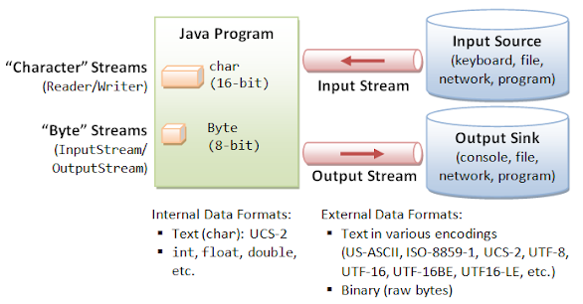
Input and Output Streams

Slide 34
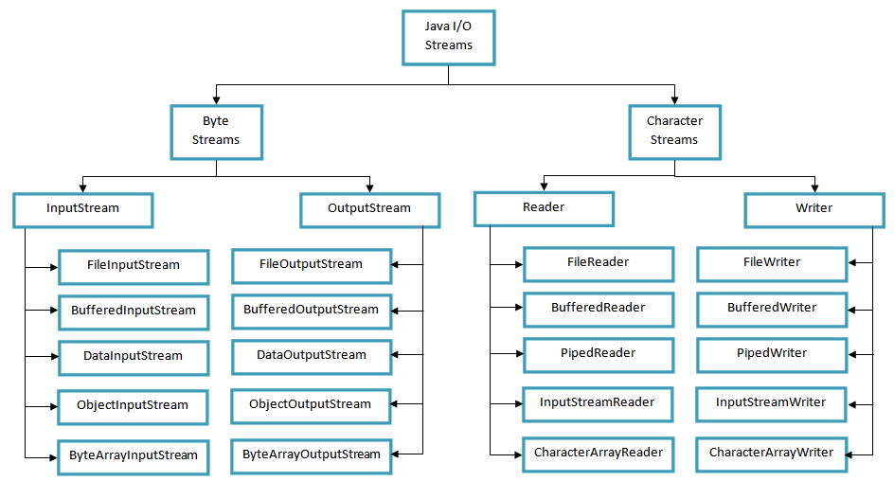
Java I/O Stream

Slide 35
What Is A Binary File?
A file that contains raw binary data is known as a binary file.
  The content of a binary file is not formatted as text, and not meant to be opened in a text editor.
The way data is stored in memory is sometimes called the raw binary format.
  Data can be stored in a file in its raw binary format.
Storing data in its binary format is more efficient than storing it as text.
  That is why much data read in as characters is converted to binary
There are some types of data that should only be stored in its raw binary format.
  Images are an example

Slide 36
Using Files in Java Programs
You must include the following statement before the class statement
  import java.util.Scanner; //if you are reading from a file (or otherwise using it)
  import java.io.*;
or the following 3 specific classes in the java.io package
  import java.io.File;
  import java.io.PrintWriter; (if you are writing to an output file) – I will be using PrintWriter throughout although there are other writers available
  import java.io.IOException;
You must also include the statement
  “throws IOException”
  after the parentheses of any method that uses File class methods, or calls a method that uses File class methods:
public static void main (String [] args) throws IOException

Slide 37
Using Files in Java Programs – Input Files (1)
You must also create a File object in the program using the “new” parameter
  This is necessary to use Java methods
File inputFile = new File(“filename”);
  If the filename isn’t in the same directory as the class file you must use the full path name
    “filename” must exist for an input file (output files can be created on the fly)
You can create a String variable with the filename first – allows greater flexibility –
  i.e. String inputFileName = “input.txt”;
  Then you say
  File inputFile = new File(inputFileName);

Slide 38
Using Files in Java Programs – Input Files (2)
You should request the file name from the user (this is how it is usually done) – Please do this (see below) in all your submittals, rather than hardcoding the file names.
If you hardcode your file name there will be a deduction of several points.
  Scanner keyboard = new Scanner(System.in);// This is a Scanner used to read input typed from the keyboard
  System.out.printf("Please enter name of file to read from: ");
  String inputFileName = keyboard.nextLine();//Get the physical file name
  File inputFile = new File(inputFileName); // Creating the File Object

Slide 39
Using Files in Java Programs – Input Files (2)
You need to use the File method .exists() before creating a Scanner for an input file
  i.e. inputFile.exists(); //if it doesn’t exist you can capture this fact
  exists() return true if an input file exists, false otherwise
  if (!inputFile.exists())
  {
  System.out.printf("Error: %s not found.\n”, inputFileName);
  System.exit(0); //This will cause you to exit the program if there is no input file to read from
  }
  You must check to see if the file exists before creating the Scanner object
    You will get an IOException if the physical file doesn’t exist
    You can also use a try and catch structure to accomplish the same result without exiting the program
Finally create a Scanner for the new input file
Scanner inputReader = new Scanner(inputFile);// inputFile is the java object
Once this is done you can use the same input functions as you have used previously – i.e. nextInt(), nextLine(), …

Slide 40
Using Files in Java Programs – Input Files (3)
You want to use the Scanner method hasNext()
  i.e. inputReader.hasNext();
  This looks at the next item but doesn’t move the pointer value (position)
  This method returns a false when you reach the end of an input file
  There are also specific hasNext() mechanisms i.e. hasNextInt(), etc.
You should close the file that the Scanner is reading from at the end
  Use the method close(); i.e. inputReader.close();
    This is a Scanner method
See TestFileInput.java and TestFileInputV2.java
  Use quotations.txt

Slide 41
Visualizing the Objects Used When Creating A Scanner
The Scanner object
The File object
inputReader
inputFile
inputFile (name of file object)
hasNext() nextInt() nextLine() nextInt() close() o 0 0
inputFileName (String with physical file name)
exists() o 0 0

Slide 42
Using Files in Java Programs – Output (1)
Using an output file involves almost the same process
File outputFile = new File(“filename”);
  If the filename isn’t in the same directory as the class file you must use the full path name – the output file doesn’t have to exist prior to creating the file object, so you don’t need to test for existence
  You can create a String variable with the filename first – allows greater flexibility i.e.
String outputFileName = “output.txt”; //This can also be read in (see Scanner notes) – Please do this (see below) in all your submittals, rather than hardcoding the file names.
  Scanner keyboard = new Scanner(System.in);// This is a Scanner used to read input typed from the keyboard
  System.out.printf("Please enter name of file to write to: ");
  String outputFileName = keyboard.nextLine();//Get the physical file name
  File outputFile = new File(outputFileName); // Creating the File Object
PrintWriter outputWriter = new PrintWriter(outputFile);
outputFile is a reference variable for a new object of type File
outputWriter is a reference variable for a new object of type
PrintWriter
See CaesarCipherFromFile.java (use caesar_input.txt)
The above file has both the input and output templates you need

Slide 43
Using Files in Java Programs – Output (2)
Now you can use outputWriter to write to the file
i.e. outputWriter.printf((“%s\n”, message);
You need to close the file that the PrintWriter is writing to at the end
  Use the method .close(); i.e. outputWriter.close();
  close() is a method associated with the Scanner and with PrintWriter
  Once you close the File associated with PrintWriter if you reopen it you will start writing over it from the beginning
  You can use FileWriter instead to allow for appending

Slide 44
Using Files in Java Programs – Output (3)
If you want to append data to the end of a file you need to use FileWriter
  This class is very similar to File, but is created with two instance variables
  The second value is set to true if you wish to append, false otherwise
  Scanner keyboard = new Scanner(System.in);// This is a Scanner used to read input typed from the keyboard
  System.out.printf("Please enter name of file to write/append to: ");
  String outputFileName = keyboard.nextLine();//Get the physical file name
  FileWriter outputFile = new FileWriter(outputFileName, true); //allows you to open the file and true means that you want to append to the file.
  PrintWriter outputWriter = new PrintWriter(outputFile ); // Writing to the physical file outputFile
Still need to close the PrintWriter object when done
outputWriter.close();
See FileAppendExampleUsingPrintWriter andAppendingToAFile.java
Note: You could use FileWriter directly but it is much more limited:
The primary purpose of a FileWriter is to write characters to a file. However, PrintWriter has more functionalities. It can write to other output streams apart from a file. Also, it provides a method to write formatted text to a file or console.

Slide 45
Visualizing the File Objects for A PrintWriter
The PrintWriter object
The File object
outputWriter
outputFile (name of the file object)
printf() print() println() close() 0 0 o
outputFile
outputFileName (String with physical file name)
exists() o 0 0

Slide 46
Visualizing the File Objects for A FileWriter
The PrintWriter object
The FileWriter object
outputWriter
outputFile (name of the file object)
printf() print() println() close() 0 0 o
outputFile
outputFileName (String with physical file name) boolean appendIndicator
exists() o 0 0

Slide 47
Examples: Reversal.java and Reversal2.java
Read in lines one by one from an input file, reverse all the characters from the input file, and write the results to an output file. Perform the reversal in a separate method called reverser
Strategy
  Create an input text file
  Read in the names of the files to read from and write to
  In the code create your File, Scanner and PrintWriter Objects
  Read in text a line at a time from the file until file is completely read
  Call reverser to reverse the text
    reverser processes in the characters in the String from back to front to create the new String which it passes back to main
    Alternatively read the String from front to back and append each new character to front of the new String
  Write the String to the output file
  Use input_for_reversal.txt and reversed.txt

Slide 48
Example EncryptFile.java
Write a program that encrypts a file of text one-line at a time using an interactively supplied code word and after capitalizing the text outputs that text to an output file. Assume that the text line contains only alpha characters and no white spaces. Use the code word, which has no spaces, as follows:
  Convert the code word to capitalized code word
  Use the code word one character at a time to shift corresponding character in message by the position of the code word i.e. if Code word is Dram and word to be coded is Hungrier shift as follows:
  H – 3, U – 17 N – 0, G – 12, R – 3, I – 17, E – 0, R – 12;
Strategy:
  Create necessary objects for input and output
  Figure out shift
  Shift character i based on the position in the alphabet of the character in the code word, going through the code word characters in a round robin method
  Add character to message line
  When complete print line to the output file
See EncryptFile.java – use file_to_encrypt.txt and encrypted_output.txt

Slide 49
The Random class

Slide 50
The Random class (1)
The Random class is another class that is imported with
import java.util.Random; or with import java.util.*;
  The Random class has many different “random” methods, making it more useful than the Math.random() method
    Math.random() is a method within the Math class, while Random is a separate class with its own methods
Remember how we achieved the ability to read input from the screen:
  Scanner keyboard = new Scanner(System.in);
Then we had a keyboard reader that could take advantage of all the methods in the class:
  int number = keyboard.nextInt();
  double decNumber = keyboard.nextDouble();

Slide 51
The Random class (2)
So lets create a new object called randy from the class Random
Random randy = new Random();
  Note that there are no data attributes in this instantiation
    When no seed is provided the seed defaults to the 64 bit integer (type long) representation of time of day – that is why each run may be different
  randy is a reference variable that now has a value (a reference to a memory location)
You can also create a Random object with a fixed seed which is a long integer (or therefore byte, short or int due to casting up);
  You then get the same sequence of numbers each time you run the program
  Note: Some classes, such as Random, have multiple constructors – the constructor is in fact overloaded
Random randy1 = new Random(seed);//seed is any type of integer including long
This can also be done using setSeed(seed):
Random randy = new Random();
randy.setSeed(seed);
In either case we can then use the methods of Random:
int number = randy.nextInt(n); // returns an integer greater than or equal to zero but less than n (where n is an integer)

Slide 52
The Random class (3)
Method & Description
boolean nextBoolean() This method returns the next pseudorandom, uniformly distributed boolean value from this random number generator's sequence.
void nextBytes(byte[] bytes) This method generates random bytes and places them into a user-supplied byte array.
double nextDouble() This method returns the next pseudorandom, uniformly distributed double value between 0.0 (inclusive) and 1.0 (exclusive) from this random number generator's sequence.
float nextFloat() This method returns the next pseudorandom, uniformly distributed float value between 0.0 (inclusive) and 1.0 (exclusive) from this random number generator's sequence.
double nextGaussian() This method returns the next pseudorandom, Gaussian ("normally") distributed double value with mean 0.0 and standard deviation 1.0 from this random number generator's sequence. http://www.javamex.com/tutorials/random_numbers/gaussian_distribution_2.shtml
int nextInt() This method returns the next pseudorandom, uniformly distributed int value from this random number generator's sequence.
int nextInt(int n) This method returns a pseudorandom, uniformly distributed int value between 0 (inclusive) and the specified value (exclusive), drawn from this random number generator's sequence.
int nextInt(int low, int upper) This method returns a pseudorandom, uniformly distributed int value between low (inclusive) and high(exclusive), drawn from this random number generator's sequence.
long nextLong() This method returns the next pseudorandom, uniformly distributed long value from this random number generator's sequence.
void setSeed(long seed) This method sets the seed of this random number generator using a single long seed.

Slide 53
The Random class (4)
Use randy.nextInt(int int1, int int2) is much easier
  This generates a number from int1 (inclusive) and int2 (exclusive)
  This means that if int x = randy.nextInt(int1, int2) then:
  int1 <= x < int2
An example with dice
Random die = new Random();
int diceSum = (die.nextInt(6)+1) + (die.nextInt(6)+1);
But much easier is
int diceSum = (die.nextInt(1, 7) + (die.nextInt(1, 7));
YOU MUST USE nextInt with the two parameters in all homework to ensure that you get the same answers as I do. Several points (on an escalating scale) will be deducted for using the single parameter method
See:
DiceRollSim.java
DiceRollSimRandomClass.java
DiceRollSimRandomClassWithSeed.java
DiceRollSimRandomClassSetSeed.java

Slide 54

A Gaussian Distribution
How nextGaussian() works

Slide 55
Using Random – An Example
Write a program that does the following:
  The main program requests from the user the dimensions of a two-dimensional array.
  The main program creates a two-dimensional array.
  The main program calls a method booleanFull that randomly fills the two-dimensional array with either true or false values in each cell.
  The main program then calls a second method called calcPercent that returns the percentage of elements in the two-dimensional array that are true.
  The main program then prints out the array and on the next line prints out the percent of cells in the array that have the value true formatted to two decimal places.
Hint: You’ll need to create a Random object and use the method nextBoolean() in the booleanFull method
See RandomArrayBoolean.java

Slide 56
Strong Typing In Java and Inferred Typing

Slide 57
The var Reserved Type Name
Although java is strongly typed java does provide a mechanism for compiler time typing.
  Packaged as part of the 2018 the Java var reserved word introduced type inference to the strongly typed Java programming language.
  In the following var examples, the left-hand side of the assignment does not reference a Java types such as long, double or ArrayList. Instead, it uses the Java var reserved type name, which allows the JDK’s compiler to pick the appropriate type instead
var x = 5.5; // double is inferred
var y = System.currentTimeMillis(); // long is inferred
var z = new ArrayList<Double>(); // ArrayList is inferred

Slide 58
Why Have The var Reserved Type Name
Benefits include
  A simplified syntax for method block logic.
  A familiar syntax for JavaScript, Go, Rust and Pascal programmers.
  Easier onboarding experience for developers new to Java.
  Enhanced ease of development for methods and local blocks of code
While this mechanism is popular I still prefer that you type specifically
Note: While var is a reserved word, due to backward compatibility issues it is not a keyword, i.e.
  var var = 3.7; works since var can be the name of a variable.

Slide 59
The ArrayList Is A Generic Class With A Type Parameter

Slide 60
Data Structure Selection And Implementation Are Critical To Good Program Design
A data structure is a collection of data together with a well-defined set of operations for storing, retrieving, managing, and manipulating the data.
  An array is a data structure containing a collection of elements of the same type and with operations for storing and retrieving individual elements.
  A file is also a data structure.
  There are dozens of data structures and we will be studying a number of them throughout this course
  We begin with a review of the ArrayList because you are already familiar with it
Every data structure entails an implementation.
  An implementation of a data structure consists of an underlying storage structure along with appropriate methods that manipulate the data.
  Much of programming, and in particular object-oriented programming, consists of selecting or designing the appropriate data structures and building models based on them

Slide 61
Arrays and The ArrayList – Simple Definitions (1)
An array holds an indexed, contiguous collection of data of a single type.
  The data type can be a primitive type or a reference type.
    A reference type contains references of that type to specific objects
  Once an array is created the length (number of cells) can’t be changed
  An array always has all its cells initialized to 0, 0.0, false or the null character for primitives, or the null reference value
  Class Arrays contains various methods for manipulating arrays (such as sorting and searching).
  This class also contains a static factory method asList that allows arrays to be viewed as lists. (To be discussed in lesson 8)
  See https://docs.oracle.com/en/java/javase/21/docs/api/java.base/java/util/Arrays.html

Slide 62
Arrays and The ArrayList – Simple Definitions (2)
An ArrayList object is an indexed list of references to objects of a particular type, or subtypes of that type
  It can only contain references to objects, not primitive values
    The individual objects may be stored elsewhere
  All references must be to a single type, or subtype of the type used to instantiate the ArrayList
    Autoboxing obviates that problem of storing primitive values in an ArrayList (or any other generic structure as we will see shortly)
  An ArrayList can grow as the number of data references increases – it can resize itself, unlike an array. – at least until memory runs out
  While an ArrayList can grow or shrink, no elements are initialized. Its initial size is zero until populated with elements
  You can also easily insert elements into an ArrayList
The JVM reserves for it a contiguous part of memory. When we are adding new elements into our list, when number of elements reaches 75% of SIZE it reserves a new, contiguous part of memory and copies all of the elements.
As we will discuss in Collections, an ArrayList implements the List interface.
  It is a Collection and can utilize many of the Collections class static methods
  At that time we will also compare the ArrayList with a LinkedList
See: https://docs.oracle.com/en/java/javase/21/docs/api/java.base/java/util/ArrayList.html

Slide 63
A Simple Example Of The ArrayList
Look at ArrayListExample1.java
The example program creates an ArrayList that holds String references and then adds references to three Strings.
  The statement
  ArrayList<String> names = new ArrayList<String>();
  creates an ArrayList of String references.
  The phrase <String> can be read as "of String references”
  Note that there are "angle (sometimes called diamond> brackets" on each side of <String>.
  You can also infer a type: ArrayList<String> names = new ArrayList<>();
Examples:
  ArrayList<Student> students = new ArrayList<Student>();//default constructor
  ArrayList<String> strings = new ArrayList<String>(50); //creates an initial capacity of 50 cells
  ArrayList<Integer> numbers = new ArrayList<>();
The phrase ArrayList<String> describes both the type of the object that is constructed (an ArrayList) and the type of data it will hold (references to String).
The alName.get( int index) method returns the reference in the cell at index
  If the cell is empty, an IndexOutOfBoundsException will be thrown and the program will halt (unless there is code to handle the exception)
  Unlike an array, cells don’t automatically default to the null value as the size is the number of explicitly added – explicitly removed elements
  While you can enter a null into an ArrayList, it can only be inserted somewhere from 0 to its size -1 or at the the end

Slide 64
Picturing Instantiation Of An ArrayList of String Objects
“Amy”
String methods method1 method2 o o o
names
“Bob”
String methods method1 method2 o o o
names[0]
names[1]
names[2]
“Cindy”
String methods method1 method2 o o o
ArrayList methods
method1
method2
o
o
o
names[0] through names[2] are reference variables, each of which
refers to a String – The methods of each of the String variables are String methods, while the methods of names are ArrayList methods

Slide 65
Some Basic Rules And Definitions
A program must import the java.util package to use ArrayList:
By default, an ArrayList starts out with 10 empty cells, although you can specify a different number
  As we said, unlike in an array, cells don’t automatically default to the null value
  In fact a cell can’t be referenced until it is populated
ArrayList is a generic type which is a generic class or interface that is parameterized over types.
  This means that its constructor specifies both the type of object to construct and the type of references (or references to subtypes of the ArrayList) that the new object of type ArrayList will hold
  The type the object will hold is placed inside angle brackets like this:
  <DataType>
  Note: Arrays cannot be created as generics – remember that an array can be of a primitive type
Generics are in effect parameterized types, meaning that the data type will be defined at the time that the client class declares and instantiates an object of that class
  Now, when the ArrayList object is constructed, it will hold data of type "reference to DataType” – This is a collection of data of that particular type
Question: What type of data will values hold in each cell?
ArrayList<Integer> values = new ArrayList<Integer>();
What about: ArrayList<Number> values = new ArrayList<Integer>(); // doesn’t work with subtypes – typing must be the same even if it is for the same List

Slide 66
Constructing An ArrayList Object (1)
To declare a reference variable for an ArrayList do this:
  ArrayList<E> myArray; // E is any class that is available to the program
  myArray is a reference to a future ArrayList object. The future ArrayList object will contain an array of references to objects of type E or to a descendant class of E.
  Construct the ArrayList later on in the code:
  myArray = new ArrayList<E>();
  The ArrayList has an initial capacity of 10 cells, although the capacity will increase as needed as references are added to the list
  Cells will contain references to objects of type E (or a descendant class)
  Since constant expansion may not be very efficient, if you have an idea of what the capacity you need, start the ArrayList with that capacity
  myArray = new ArrayList<E>(int initialCapacity);

Slide 67
Constructing An ArrayList Object (2)
Just as with any other variables you can combine the two steps to both declare a reference variable and construct an ArrayList:
ArrayList<E> myArray = new ArrayList<E>();
To declare a variable and to construct an ArrayList with a specific initial capacity do this:
ArrayList<E> myArray = new ArrayList<E>( int initialCapacity );
The initial capacity is the number of cells that the ArrayList starts with.
  It can expand beyond this capacity if you add more elements.
  Expanding the capacity of an ArrayList is slow so to avoid this, estimate how many elements are needed and construct an ArrayList of that many plus some extra
You can print out an entire ArrayList using it’s toString method
  See ArrayListToString.java

Slide 68
Null and ArrayList
An ArrayList element can be an object reference or the value null
When a cell contains null, the cell is not considered to be empty. The picture shows empty cells with an "X" and cells that contain a null
Remember in an ArrayList a cell is not automatically initialized to null
You’d need to say:
  names.add(null); //no quotes; adds to
  end of list

Slide 69
Capacity And Size
The capacity is the total number of cells in an ArrayList
  Capacity cannot be retrieved (it is internal to the JVM)
The size is the number of cells that have data in them.
  Cells 0 up through size-1 have data in them
  By data we mean a reference value, or the value null
Data are added in order. Before cell N gets data, cells 0, 1, 2, ... N-1 must hold data
  This doesn’t mean that you can’t insert data in between populated cells (as we will see)
  However, you can’t add elements and leave blanks (You must insert a null to reserve a cell)
The size increases by one each time an element is added
However, the capacity remains unchanged until the ArrayList is full
  When an element is added to a full list, the Java runtime system will greatly increase the capacity of the list so that many more elements can be added.
To find out the current size of an ArrayList use its size() method:
names.size() returns the size of names

Slide 70
The ArrayList Implements The List Interface
An ArrayList is a resizable-array, ordered implementation of the List<E> interface that permits all elements including null.
  ArrayList allows random access to elements and is similar to Vector apart from being unsynchronized.
This type of list is a good choice when you want fast access and iteration but are not doing a lot of insertions and deletions.
We return to List in Lesson 8

Slide 71
Common Methods Of The ArrayList class (1)
Method Name | Description | Example
void add(int index, Object element) | Inserts the specified element at the specified position index in the ArrayList. Throws IndexOutOfBoundsException if the specified index is out of range (index < 0 || index > size()) | See ArrayListExampleAddAtIndex.java
boolean add(Object o) | Appends the specified element to the end of this list | See ArrayListExample1.java, CharacterArrayListExample.java
void clear() | Removes all of the elements from this ArrayList | names.clear() empties the cell, it does not place the null address in the cell. Size() returns 0 See ArrayListExample2.java
void ensureCapacity(int minCapacity) | Manually increases the capacity of this ArrayList instance, if necessary, to ensure that it can hold at least the number of elements specified by the minimum capacity argument. | names.ensureCapacity(15); increases capacity to at least 15
Object get(int index) | Returns the element at the specified position in this list. Throws IndexOutOfBoundsException if the specified index is out of range (index < 0 || index >= size()). | See ArrayListExampleAddAtIndex.java For our example of names names.get(1) returns a reference to the String “Bob” Also see CharacterArrayListExample.java
boolean contains(Object obj) | Return true if the equals is true for an object in the ArrayList | See ArrayListExampleContains.java

Slide 72
Common Methods Of The ArrayList class (2)
Method Name | Description | Example
int indexOf(Object o) | Returns the index in the ArrayList of the first occurrence of the specified element, or -1 if the ArrayList does not contain this element. | See ArrayListExampleRemove.java
int lastIndexOf(Object o) | Returns the index in the ArrayList of the last occurrence of the specified element, or -1 if the ArrayList does not contain this element. | See ArrayListExampleRemove.java
Object remove(int index) | Removes the element at the specified position in the ArrayList. Throws IndexOutOfBoundsException if the index out is of range (index < 0 || index >= size()). | See ArrayListExampleRemove.java
Object set(int index, Object element) | Replaces the element at the specified position in the ArrayList with the specified element. Throws IndexOutOfBoundsException if the specified index is out of range (index < 0 || index >= size()). | See ArrayListExampleSet.java
int size() | Returns the number of elements in the ArrayList. | See ArrayListExample1.java
void trimToSize() | Trims the capacity of this ArrayList instance to be the ArrayList’s current size.
Iterator iterator() | Returns an iterator object that can be used to go through a list | See ArrayListExampleIterator.java

Slide 73
What Is The SequencedCollection Interface
The Sequenced Collections feature injects new interfaces into the existing hierarchy, offering a seamless mechanism to access the first and last elements of a collection using built-in default methods.
  Moreover, it provides support to obtain a reversed view of the collection.
  This has been done for consistency

Slide 74
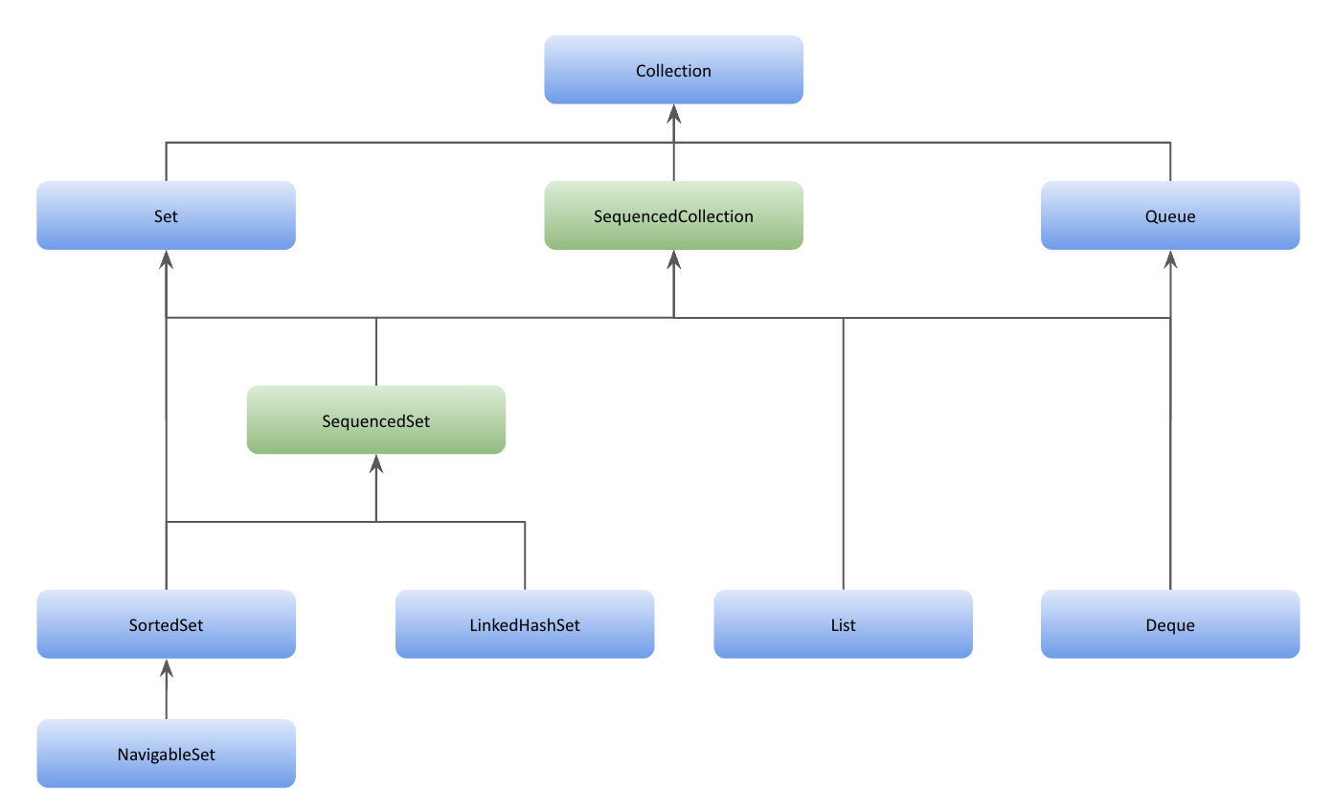
The SequencedCollection Interface – New In Java 21
Only LinkedHashSet is a class on this chart

Slide 75
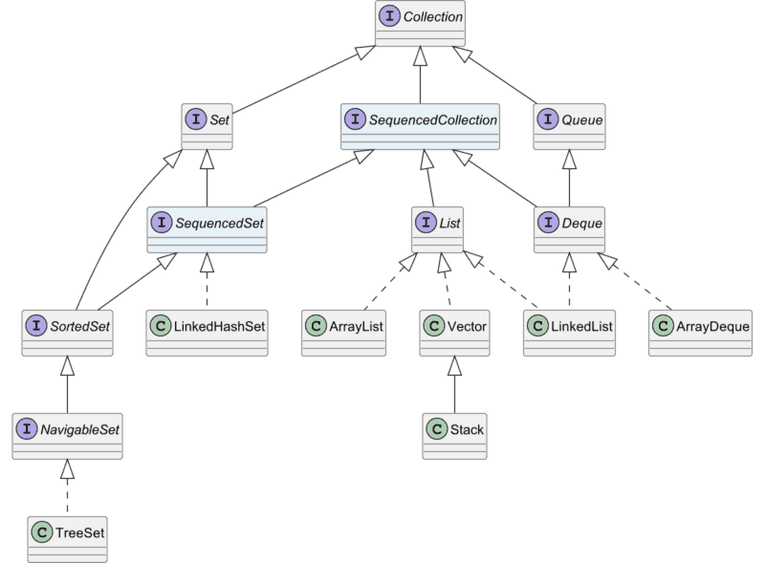
The SequencedCollection Interface – IFs and Classes

Slide 76
What Is The SequencedCollection Interface In Detail
This chart will be discussed in detail in Lesson 7
The Sequenced Collections feature injects new interfaces into the existing hierarchy, offering a seamless mechanism to access the first and last elements of a collection using built-in default methods.
It is a collection that has a well-defined encounter order, that supports operations at both ends, and that is reversible.
  The elements of a sequenced collection have an encounter order, where conceptually the elements have a linear arrangement from the first element to the last element. Given any two elements, one element is either before (closer to the first element) or after (closer to the last element) the other element.
  This definition does not imply anything about physical positioning of elements, such as their locations in a computer's memory.
Several methods inherited from the Collection interface are required to operate on elements according to this collection's encounter order.
  For instance, the iterator method provides elements starting from the first element, proceeding through successive elements, until the last element.
  Other methods that are required to operate on elements in encounter order include the following: forEach, parallelStream, spliterator, stream, and all overloads of the toArray method.
This interface provides methods to add, retrieve, and remove elements at either end of the collection.
This interface also defines the reversed method, which provides a reverse-ordered view of this collection. In the reverse-ordered view, the concepts of first and last are inverted, as are the concepts of successor and predecessor.
  The first element of this collection is the last element of the reverse-ordered view, and vice-versa. The successor of some element in this collection is its predecessor in the reversed view, and vice-versa.
  All methods that respect the encounter order of the collection operate as if the encounter order is inverted.
  For instance, the Collection.iterator() method of the reversed view reports the elements in order from the last element of this collection to the first

Slide 77
New Methods Of The ArrayList class Added In Java 21 – Inherited Via SequencedCollection
Method Name | Description
default void addFirst(E e) | Adds an element as the first element of this collection (optional operation). After this operation completes normally, the given element will be a member of this collection, and it will be the first element in encounter order.
default void addLast(E e) | Adds an element as the last element of this collection (optional operation). After this operation completes normally, the given element will be a member of this collection, and it will be the last element in encounter order
default E getFirst() | Gets the first element of this collection.
default E getLast() | Gets the last element of this collection.
default E removeFirst() | Removes and returns the first element of this collection
default E removeLast() | Removes and returns the last element of this collection
SequencedCollection<E> reversed() | Returns a reverse-ordered view of this collection. The encounter order of elements in the returned view is the inverse of the encounter order of elements in this collection. The reverse ordering affects all order-sensitive operations, including those on the view collections of the returned view. If the collection implementation permits modifications to this view, the modifications "write through" to the underlying collection. Note this is implemented as a default method in List Note: Doesn’t change the original ArrayList
Note all but reversed (which is abstract) are default, but are typically
overridden in the specific implementation
The add*() and remove*() methods are optional and throw an UnsupportedOperationException in their default implementation, primarily to support the case of unmodifiable collections and collections with an already defined sorting order.
The get*() and remove*() methods throw NoSuchElementException if the collection is empty.
See SequencedALExample.java

Slide 78
The Iterator interface

Slide 79
Using The Iterator And iterator() Method
Often you wish to access the elements of an ArrayList one by one, in order
  You could write a counting loop
  You can use an Iterator object.
The Interface Collection Iterable interface (in java.lang) provides an iterator() method that returns a reference for an Iterator over the elements in this list in proper sequence, which allows a program to walk through the collection and remove elements from the collection during the iteration.
  Note the Iterator reference only works for classes that implement Iterable
To get an Iterator object (in java.util), use the iterator method of the appropriate List:
Iterator<E> iterator() // Returns an Iterator i.e.
  Iterator<String> iter = names.iterator(); //creates an Iterator object
  Note: The method iterator() creates the Iterator interface (we don’t use new directly)
  ArrayList implements the Iterable interface
  iterator() is the only non-default method in this interface
An Iterator object is used to visit the elements of a list one by one
  It visits only the cells that have data (so you don't need to worry about going past the end of data)
  This is more convenient than writing a loop
  Need to be careful if you insert null values and then try to use methods with a null reference

Slide 80
Iterator Methods
An iterator implements the Iterator<E> interface, which has the following methods:
boolean hasNext() // Returns true if not all elements have been visited – doesn’t move the cursor
  E next() // Returns the next element of the list, a reference to type E, and moves the cursor
  void remove() // Remove from the list the element just returned by next()
  There is also a forEachRemaining method which we won’t be discussing
You need to import the Iterator class:
  import java.util.Iterator;//This is required even though the method is in the Iterable interface which is in java.lang
Note: If a collection is modified by one of its methods after an iterator is created for that collection, the iterator becomes invalid
  Any operation performed with the iterator fails immediately and throws an exception.
  This is called fast-fail
    Fast-fail iterators help ensure that a modifiable collection is not manipulated by two or more threads at the same time.
  See ArrayListExampleIterator.java

Slide 81
Using The Enhanced For Loop With The ArrayList
The enhanced for loop (sometimes called a "for each" loop) can be used with any class that implements the Iterable interface, such as ArrayList
  for (ClassName currentObject: ArrayListName)
  {
  Process currentObject
  }
The program does the same thing as we showed with the Iterator
  The enhanced for loop accesses the String references in names and assigns them one-by-one to currentObject
With an enhanced for loop there is no danger an index will go out of bounds
  The enhanced for loop only visits those cells that are not empty, beginning with cell zero
  Since an ArrayList never has gaps between cells, all occupied cells are visited
See IntegersInArrayList.java

Slide 82
Using The Enhanced For Loop When Nesting
See NestedIterators.java and NestedEnhancedFor.java
In the NestedIterators.java code we are calling the next() method again and again for itr1 (i.e., for Listl).
We are advancing the iterator without even checking if it has any more elements left in the collection(in the inner loop), thus we are advancing the iterator more than the number of elements in the collection which leads to NoSuchElementException.
Both Iterator and for-each loop are faster than simple for loop for collections with no random access, while in collections which allows random access there is no performance change with for-each loop/for loop/iterator.

Slide 83
Programming Exercises
CollegeTranscript
A text file stores the courses you have taken along with the corresponding grade (A,B,C, D, F) that you received in each course. The file might look like:
Intro to Sociology A
Physics B
Experimental Psych C
o
o
o
Write a program that uses such a file to calculate a GPA. Print the GPA with two decimal places.
Use collegetranscript_file.txt

